Slide 1

CS 250 Final Project: Agile Presentation
Kenneth Pinkerton

Slide 2


Agenda
Overview of Agile Methodology
The roles on a Scrum-agile Team
The phases of the SDLC work in an agile approach
How the process would have been different with a waterfall development approach
Factors to consider when choosing a waterfall approach or an agile approach

Slide 3


Scrum-Agile Methodology
“Scrum is an agile software development model based on multiple small teams working in an intensive and interdependent manner. The term is named for the scrum (or scrummage) formation in rugby, which is used to restart the game after an event that causes play to stop, such as an infringement. Scrum employs real-time decision-making processes based on actual events and information.”₁
While this is perhaps where Agile began it has since evolved over time and is a series of principles that helps to govern how a project is carried out that focuses on generating value as quickly and efficiently as possible.₂

Slide 4



Overview of Agile Methodology

Slide 5




What is Agile?
Agile is defined by a set of guiding principles rather than any set practices or tools. This allows for Agile to be more responsive to a given situation and varied in any given approach that is used. On the next slide we’ll go over the specific points of what Agile is, but below are the 5 key take-aways of agile.₂
Increase focus on business outcomes.
Reduced time to market
Higher productivity and lower costs
Higher quality
Organizational effectiveness

Slide 6
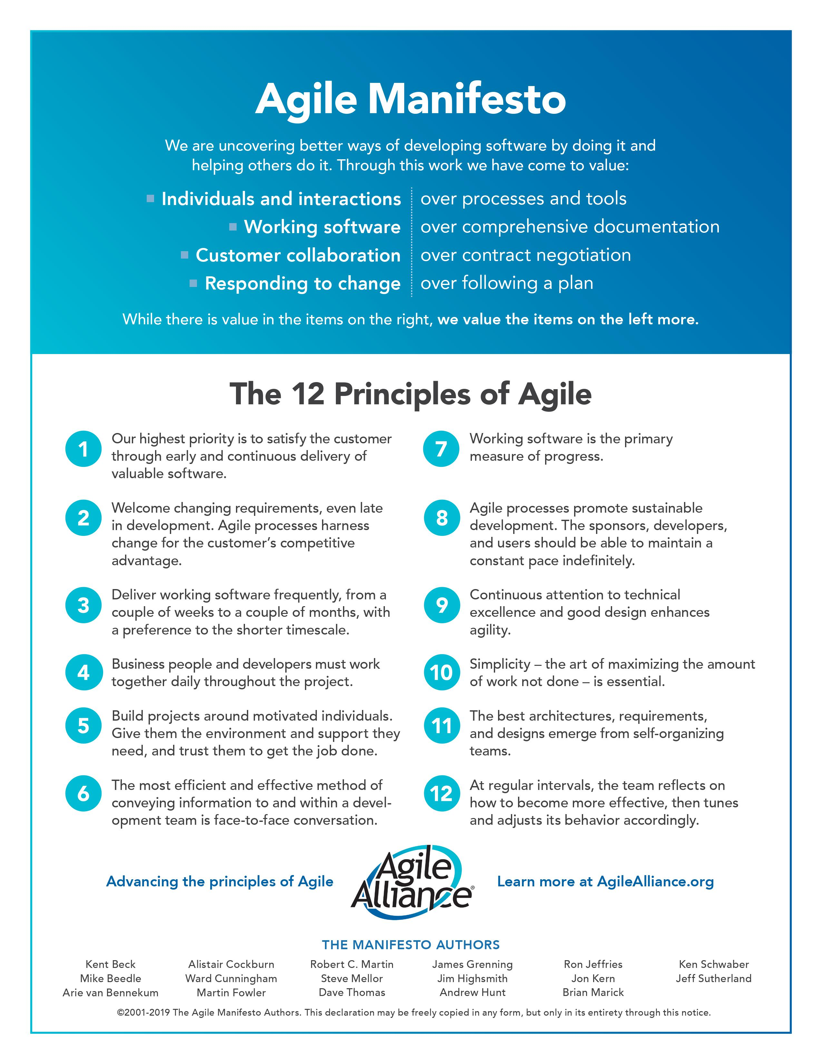

Slide 7




Scrum-Agile team
Tester
Developer
Scrum Master
Product Owner
Writes clear test cases for the rest of the team.
Ensures that all users stories are implemented correctly.
Defines clear pass/fail metrics for all user stories
Creates robust and clear code to achieve user story goals
Clearly communicates with rest of the team to ensure all requirements are met..
Driving force behind the team’s development process.
Works to resolve any roadblocks that other members of the team may have.
Makes sure that team stays on track and helps to remove distractions and improve team cohesion.
Helps prioritize backlog with the product owner.
Works as a liaison between the team and client.
Prioritizes backlog items to make sure team stays on track with deadlines.
Defines user stories from the client that the team uses to build from.

Slide 8
phases of the SDLC

Slide 9
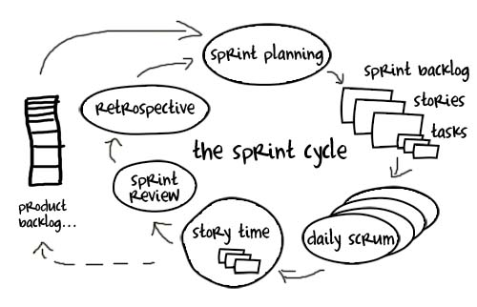
Phases of the SDLC in Agile
In agile there are several unique phases to each sprint that the team goes through every set unit of time, usually a sprint is anywhere from 1 week to 1 month. This timeframe is determined by the team. This time is kept consistent so that it becomes easier to gauge progress and the velocity of the team. The image to the right was found here.₃
Sprint planning
Team comes together to discuss items that must be completed during the sprint. And determine user stories that will be accomplished within the sprint.
Daily Scrum meetings
Team meets briefly everyday to review where the team is at on tasks and what roadblocks they have if any.
Story time/Product Backlog Refinement
Usually performed weekly for 1 hour. Allows team to determine appropriate size of stories, whether these need to be split into separate stories, and what acceptable acceptance criteria is.
Sprint Review
Stakeholders/clients may be invited to this meeting. This meeting is where the team reviews what was accomplished and discusses why some things were not done that were committed to if any.
Sprint Retrospective
Allows the team to define what they learned during the sprint and allows the team to decide on one or two strategic changes that need to be made to improve the team’s efficiency.

Slide 10
The waterfall method

Slide 11
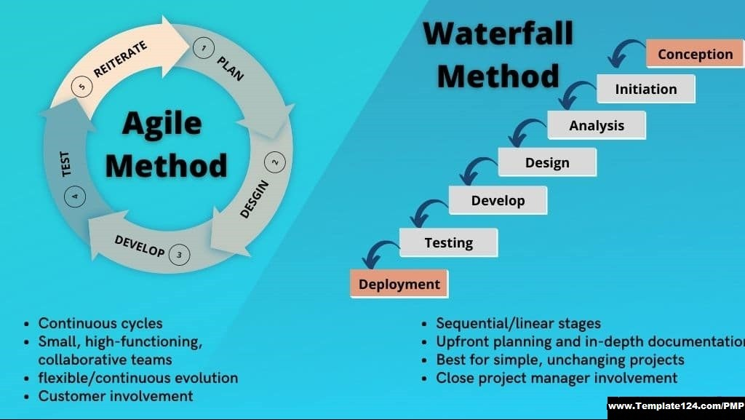
Phases of the SDLC in Agile
Waterfall / Agile Comparison₄
In the context of this project, this project would have proceeded much differently if the waterfall method had been used. As the illustration on the left shows each step under waterfall flows from the last, and there is not an in-built method of returning to an earlier phase without substantial rework or restarting of the project. This could have been disastrous in this project as this was a new development and there were aspects that did change during its course such that if the project had continued under the waterfall method there would have been substantial costs associated with reworking portions that had already been done, or the project being at a point that it would be impossible to tell how those changes may have transpired or turned out.
For instance, during the project there was a point where the client had come back and decided that a more generalized approach of niche travel destinations was not the direction they wanted to go from an executive point and new data had come up prompting them to pivot instead to wellness and detox vacations. Under Agile this was able to be more easily implemented because the portion that was changed was modular and only a small piece that had minor reworking associated with it. However, under the waterfall method this piece may have been fully completed or otherwise not in a state that it could be so easily changed.

Slide 12

Agile V.s. Waterfall for future projects
When I undertake future projects, my initial inclination is to lean towards an Agile methodology.
This is due to Agile being far more responsive to changing circumstances, as well as a greater focus is put onto creating value as quickly as possible.
This is done through breaking down of the project into smaller subsections, or user stories. By then incrementing the project it becomes easier to take a large project and break it down into more manageable sections. This also adds the benefit of allowing the client to see exactly where the project is and to see it taking shape over time.

Slide 13

References
Margaret Rouse, “Scrum,” TechTarget, February 2007, http://searchsoftwarequality.techtarget.com/definition/Scrum.
Charles G. Cobb. (2015). The Project Manager’s Guide to Mastering Agile : Principles and Practices for an Adaptive Approach. Wiley.
Johnson, C. S. (2023, December 10). Scrum: A Breathtakingly Brief And Agile Introduction. Retrieved from Agile Learning Labs: https://agilelearninglabs.com/resources/scrum-introduction/
Muhammad Omair PfMP, P. P. (2023, December 10). Agile Project Management Methodology vs. Waterfall Project Management Methodology: Understanding the Differences. Retrieved from LinkedIn: https://www.linkedin.com/pulse/agile-project-management-methodology-vs-waterfall-pmp-pmi-acp-/

